Slide 1
Central Dissemination Project
1.4.2014
(Muscat, Oman)

Slide 2
OUTLINE
Introduction
Current System
Deficiency Of Current System
Advantages Of Central Database
Indicators Model For Central Dissemination
Data Process Of Central Dissemination Database
Tables of Project
Web Application for Independence Statistical Indicators
GVYU Application and MEDAS Application

Slide 3
INTRODUCTION
Dissemination databases are the summary aggregated data repository
which are created from institutional databases according to the information request
Aggregated time series data created from TurkStat institutional databases.
They are accessible from Web Page
Dissemination databases are for end users but not for beginners
Users takes data from database according to the given criterias.Reports are dynamically produced.

Slide 4
While disseminating data on the web page, data confidentiality are considered. All data at the institutional database are not included at dissemination database
TR, Nuts1 (12 region), Nuts2 (26 region), Nuts3(81 city),
Town and Municipality level data is accessible through Institutional Database

Slide 5
CURRENT SITUATION
A java application for selecting report parameters
Sending parameters via URL to report server
Oracle Reports Builder handles the requests

Slide 6
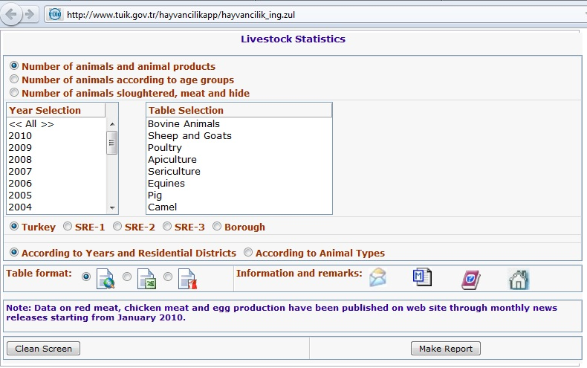
A Current Java Application
http://rapor.tuik.gov.tr/reports/rwservlet?hayvancilik...

Slide 7
… Why do we need to design a central database for dissemination?

Slide 8
Deficiency of Current System:
For each application gathering the same data with different ways
Different database designs
Different application for each subject of statistics

Slide 9
Advantages of Central Database:
Reduce actual reporting burden
Administrative simplification
Generic data
Uniform report helps the web service development and administration in the future.

Slide 10
Indicators Model for Central Dissemination
Indicator: Identifier information except time (year, month, quarter) and location (region).
We assume that Each given statistic is an indicator.
Example:
Exchange ratio of unemployment rate for male population in Ankara on March,2000, is 0.3.

Slide 11
Indicators Model (Cont’d)
Data is composed of :
Time – Level – indicator - Value – Metadata
Examples of Population indicators
Population
Male population
Male - literate – population
Male - illiterate –populatin
Female - literate – population

Slide 12
Indicators Model (Cont’d)
Example :
For unemployment suppose that having 3 dimensions.
Gender : 2 codes,
Education : 10 codes,
Occupation : 300 codes
Indicators:
unemployment with no dimension : 1
With 1 dimension : 2 + 10 + 300 = 312
With 2 dimensions : 2*10 + 2*300 + 300*10 = 3620
With 3 dimensions : 2*10*300 = 6000

Slide 13
Indicators Model (Cont’d)
Each indicator should have identification code.
Indicator : Measurement + Dimensions
There are also indicators that don’t include any dimension (independence indicator)
Measurements and Dimensions MUST be coded.
A classification server should be used for all projects for dimension codes

Slide 14
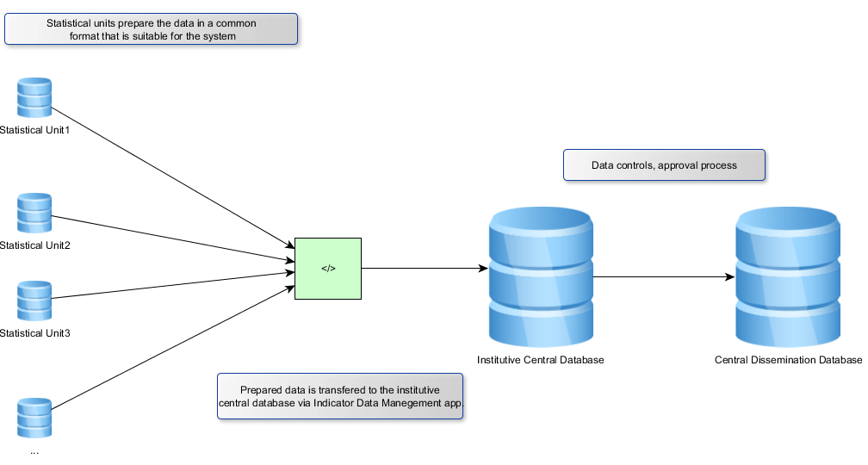
Data Process of Central Dissemination Database

Slide 15
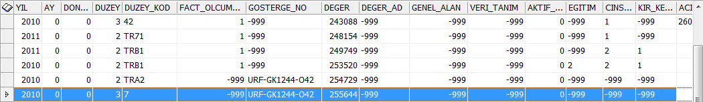
Fact Table Structure
dimensions
time
place
value
There is a standart fact table structure for each project
Dimension codes should exist in the classification server
Updating of the Classification server should affect all projects So be Careful !

Slide 16
Fact Table Columns
YIL, AY, DONEM: Time
DUZEY, DUZEY_KOD: Place
FACT_OLCUM_NO: measurement id
GOSTERGE_NO: Indicator id
DEGER, DEGER_AD: Value
GENEL_ALAN: the reason of new data (data / metadata)
VERI_TANIM : flag for hiding data
AKTIF_PASIF: active/passive
DIMENSION ALANLAR: dimension columns
ACIKLAMAn, ACIKLAMAn_ING (n:max 10): Metadata

Slide 17
METADATA
For each indicator (in indicator table)
For each record
There are 10 metadata column in fact table
METAVERI_BILGI table contains metadata

Slide 18
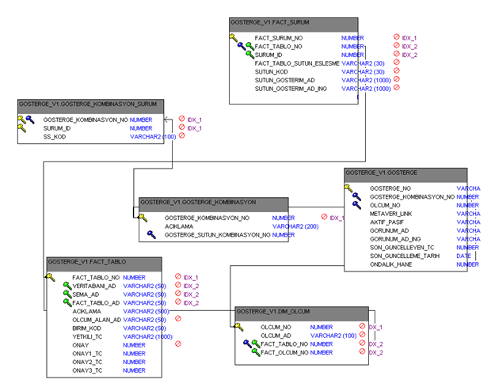
TABLES OF PROJECT

Slide 19
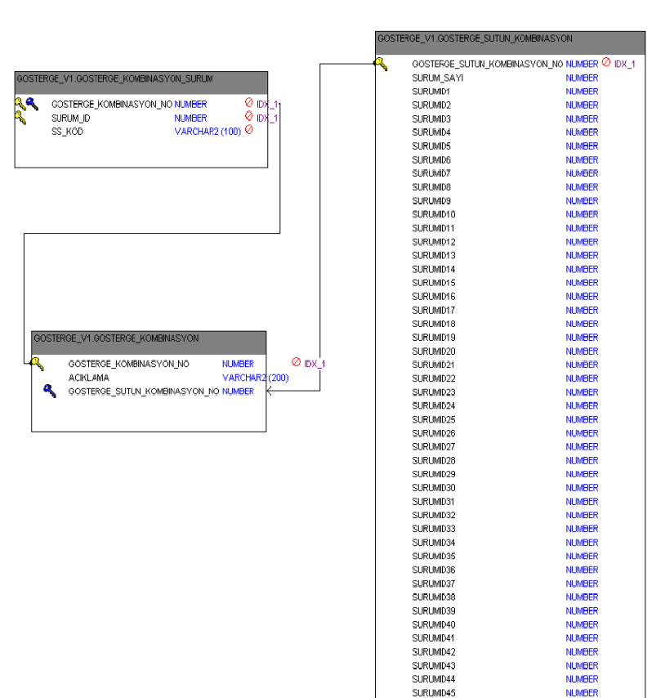
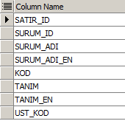
Classification server’s
Table structure

Slide 20
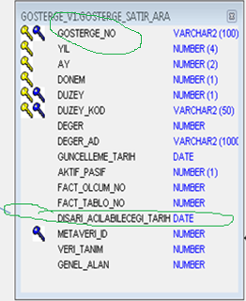
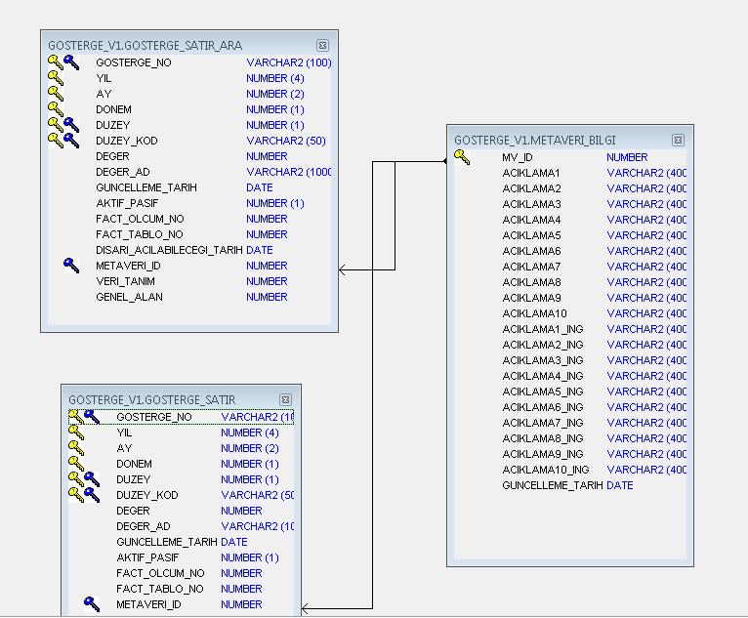
Generated data,
Waiting until release time
indicator’s
İdentification code
Release time
After release time
The data
displayed on the web page

Slide 21
APPLICATIONS
There are 3 applications
1 - Web application for Independence Statistical Indicators
(now includes 66 important indicators)
2 – GVYU - Data Management application for producing and managing data
3- MEDAS (Central Dissemination Application) : For querying
the central dissemination database

Slide 22
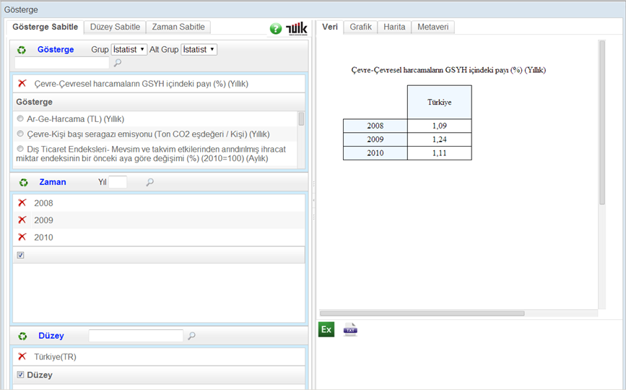
1- Web Application for Independence Statistical Indicators

Slide 23
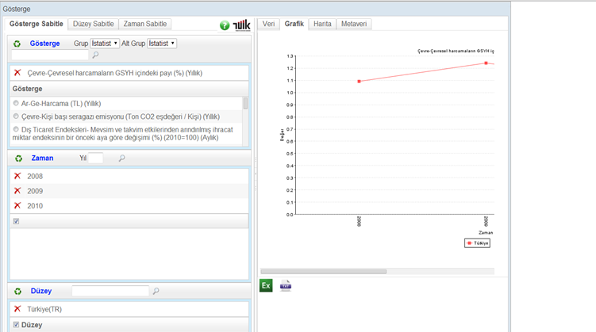
1- Web Application for Independence Statistical Indicators
(Cont’d)

Slide 24
2- GVYU Application
This application is used by TurkStat personels
This is Central Data Management Application
Java is used, web based application
Missions:
defining indicators and indicator’s metadata, generating indicator ID
Controlling department’s data before deploying
Deploying data into temporary tables
Approval mechanism
Deploying data into live dissemination table (Preparing MEDAS data)

Slide 25
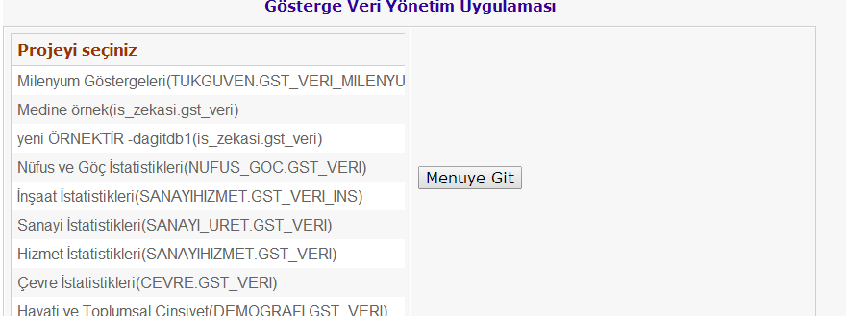
2- GVYU Application (Cont’d)

Slide 26
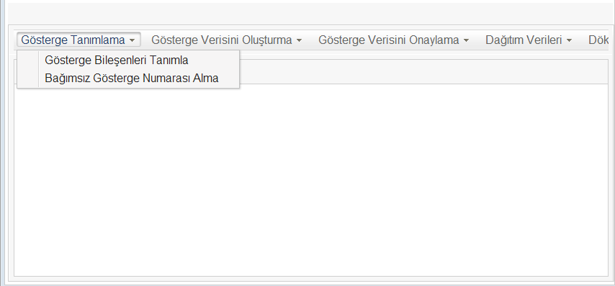
2- GVYU Application (Cont’d)

Slide 27
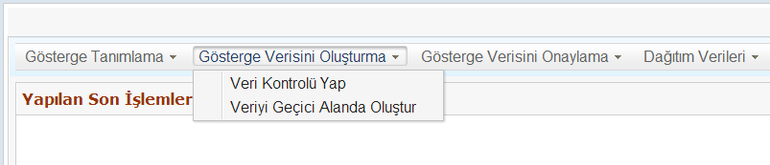
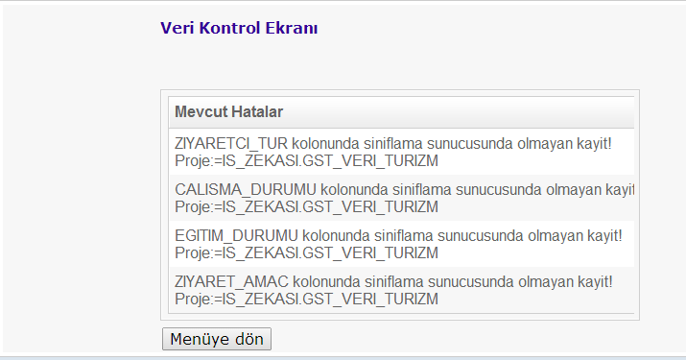

Slide 28
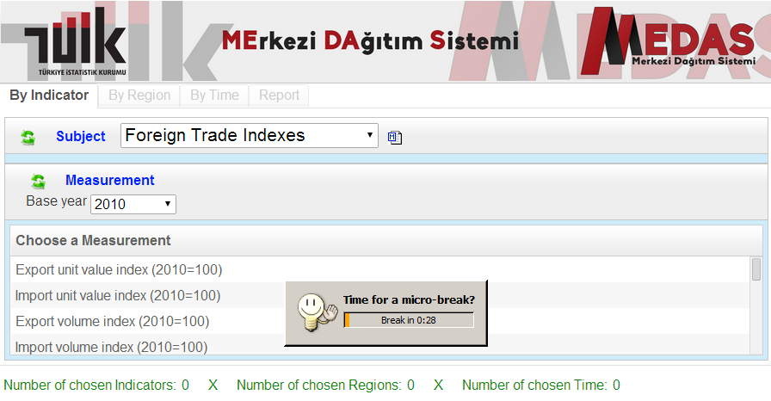
3- MEDAS APPLICATION
(Central Dissemination Application)

Slide 29
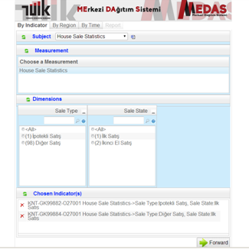
3- MEDAS
APPLICATION
(Cont’d)

Slide 30
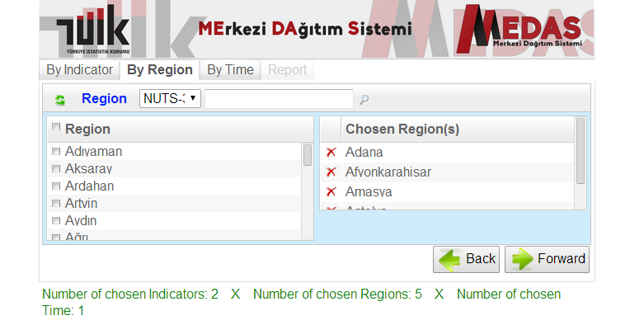
3- MEDAS APPLICATION (Cont’d)

Slide 31
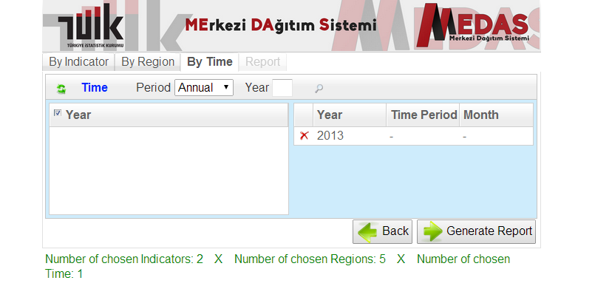
3- MEDAS APPLICATION (Cont’d)

Slide 32
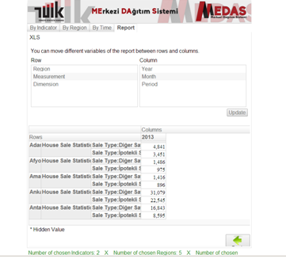
3- MEDAS
APPLICATION
(Cont’d)

Slide 33
What did we do until now in this project?
66 independent indicators are selected and are accessible through TurkStat websites (map and graphic is available for regional data)
For now, the data is given up to province level. (Nuts3) (Also TR, Nuts1, Nuts2, Town and Municipality level data is available in Instutional DB)
The Central Dissemination makes the comparision between different statistical subjects’ possible.
Till now 5 statistical units’ data is uploaded for the central dissemination and could be queried by MEDAS Application (Not accessible on web page yet)

Slide 34
SUMMARY
We use Indicator Model in Central Dissemination Database
Indicators are generated using dimensions using a software program
Central Dissemination System reduces reporting burden
Central Dissemination System simplify administration of data
End users can get dynamic reports, pivot reports and can export report to Excel
We are developing the system, not finished yet

Slide 35
Important Notes
Seperating the databases is important and necessity. Production database should include current data. Institutional database should contain both current and historical data. Dissemination databases should include only disseminated data.
The tables structures at the Institutional DB will be similar to Production database. For generating aggregated data at Institutional database, Matealized Views may be created or SQL s are used to generate new tables.
Standardization of codes is essential
Metadata system shoud be considered
Central dissemination is mandatory

Slide 36
Thank you & Questions ?

